Slide 1
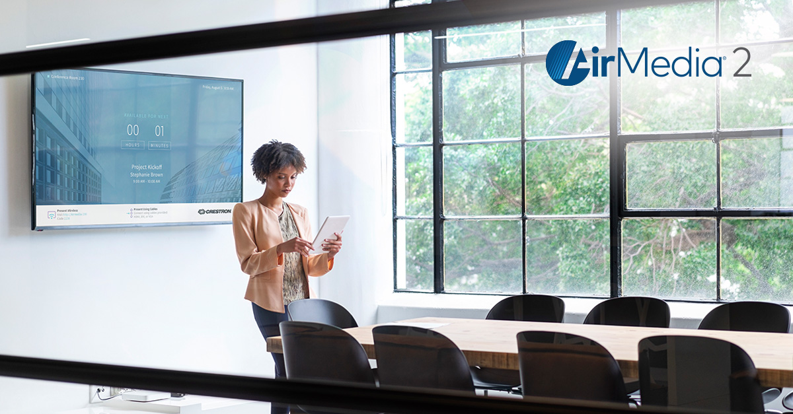
Add touchless collaboration to any space

Slide 2
Returning to the office
Safety first
People need to feel safe and be safe
New building management protocols
Crestron technology can help
Wireless presentation, collaboration, and room scheduling
from personal device
Occupancy sensors automatically turn room on/off
Room scheduling from personal device
Notes:
People need to get back to work, but when they do, they need to be, and feel, safe at work. There’s going to be some new protocols set in by facilities, building management, people are going to getting their temperature taken, a lot of new things are going to happen when they just walk in the door. I mean we still don’t really know, but we need to be prepared to have the conversations.
Crestron can help with this though technology and design assistance. There’s a lot of talk in the Consultant world going on right now and a lot of uncertainty, so hopefully everyone on the call today can walk away afterwards with some confidence to talk about how Crestron can solve some problems.
Yeah, for dealers it’s about stimulating business too. We need to show them that they need to start thinking about their integrations in a new way. That uncertainty for business can be helped by Crestron and our dealers. That’s an opportunity for their business’. We need to give them some new ideas, show them how our current tech can help the new workplace standards.
Right, look at us as a company. We’re still all remote, but the Texas office is going to start bringing in 25% of the workforce. So now we need to start thinking about how technology can help limited work staff collaborate while in the same building and with the rest of the staff at home.
So it’s strange times now, and it’s going to be at the office too. We need to make sure customers know we can help them get through this and keep their workforce effective. So stay engaged with them! They may not be thinking about how Crestron can help.

Slide 3
Room automation, intelligence, and security
Built-in room control and automation
Web-based system configuration
Pair with occupancy sensor to activate
Set rules for on and off times based on workday
No physical interaction with any device other than your own
Notes:
You have the peace of mind that conference rooms will be operational when you need them to be, and not consuming power when you don’t need them to be. AirMedia 2.0 is simple, manageable (via the Crestron XiO Cloud™ platform), and leverages existing IT security infrastructure.
The AirMedia AM-200 and AM-300 wireless presentation systems have built-in room control and automation.
You can configure the system, including peripheral devices such as a display/projector and touch screen, to automatically power on and off based on business hours you set or via occupancy (using a paired occupancy sensor).
You simply enter the room and the system is operational. Again, no physical interaction with any device other than your own.

Slide 4
Information is key
Meeting room availability
Ambient messaging and branding
Helpful onscreen instructions
Notes:
Information is key It all starts with the front of the room experience, where essential information is communicated to the meeting participants:
Meeting room availability – Connect to Microsoft Office 365®, Microsoft Exchange Server®, Google Calendar™, or Crestron Fusion® software for even more providers
Ambient messaging and branding – Scroll through a series of background images uploaded locally or on a web server; upload a custom logo; or connect to Appspace® software to allow for an even more engaging signage/messaging experience
Helpful instructions – Information to connect via wired or wireless is available front and center

Slide 5
What is AirMedia® 2.0 Wireless Presentation?
The fastest, easiest, most manageable, and secure wireless presentation technology
Simple to use
Connect from any browser on any network
Great wireless video
Smooth video playback with synchronized sound and real-time keyboard and mouse tracking from almost ANY device
Secure endpoint
Works with your existing infrastructure – not against it
Manage remotely
Deploy and update without going from room-to-room
Simple to use
Manage remotely
Great video
Secure endpoint

Slide 6
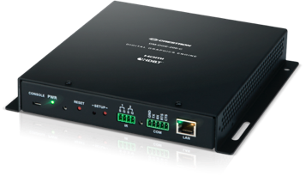
AM-200/300: AirMedia® Wireless Presentation Systems
Wired presentation
HDMI® | DM®
Whiteboard capture
Crestron AirBoard™
Front-of-room experience w/ scheduling
Wireless presentation
Native | Non-native
Touch screen integration
Switcher
Zūm® occupancy and keypad with room power management
Display control
COM | IR | CEC
Digital signage
PinPointUX | Appspace®
The Total Room Solution
Monitoring
Crestron Fusion® |
XiO Cloud®

Slide 7
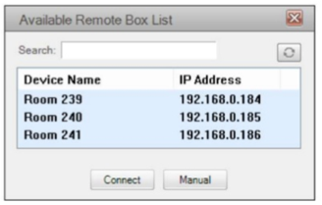
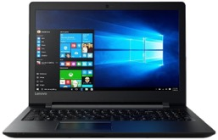
Simple to get your content on the room display
OR

Slide 8
Why wireless presentation?
Frees people to sit or stand anywhere in the room or space and easily connect their laptops and smart devices to room display, regardless of OS
No more wires or dongles cluttering table
Enables collaboration in various public spaces – e.g., cafeterias, hallways, private offices

Slide 9
Wireless sharing from YOUR device
Supports the most popular operating systems
Windows© via AirMedia app
Windows via Miracast® software
Android™
iOS®
MacOS®
Chrome OS™

Slide 10
Simple, consistent user experience in every room and space
From AirMedia app
or
Native mirroring from devices running:
Windows
MacOS
Android
iOS
Chrome OS

Slide 11
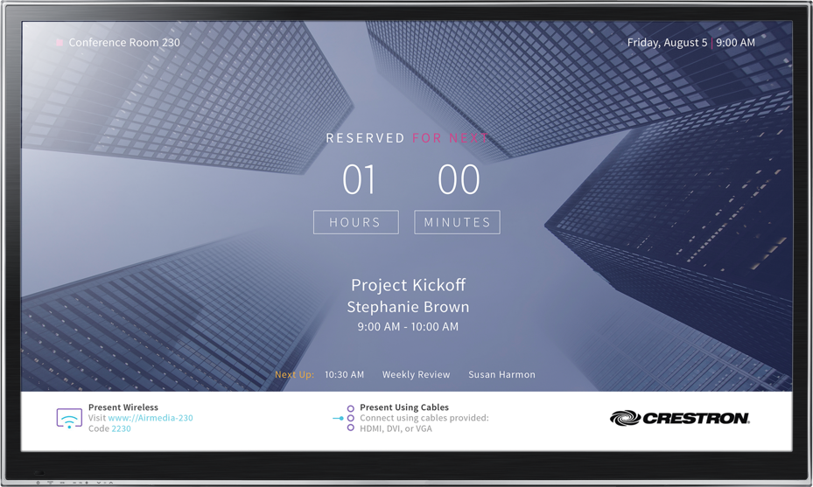
Simple, consistent user experience in every room and space
Front-of-room experience – shows room availability, meeting details, and connectivity instructions
No more wasting valuable time figuring out how to get technology in the room or space to work

Slide 12
Device agnostic
Native screen mirroring
Non-native screen mirroring
AirPlay®
Miracast
Windows
Android
MacOS
iOS
Chrome OS

Slide 13
Great video: Provides low latency critical for interactive content
Notes:
Sub <100ms latency, Average 1.4Mbps, Range of .25 to 8.5Mbps

Slide 14
Secure endpoint: Works with your existing infrastructure
Data security
Device authentication
User authorization
802.1X

Slide 15
Manage remotely: XiO Cloud™ Service
Leverages Crestron XiO Cloud™ IoT-based platform provisioning for mass configuration and firmware upgrades
Deploy – devices power on and connect up to the cloud
Manage – push firmware updates
Monitor – know about system outages before your users do
Evolve – understand how spaces are being used to drive future design decisions

Slide 16
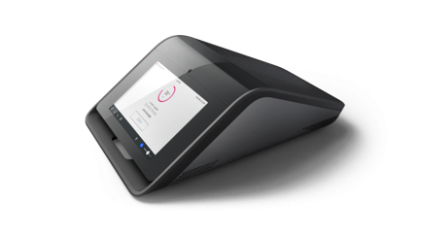
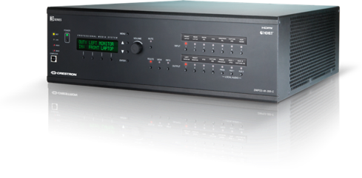
AirMedia product family
AM-200, AM-300
AirMedia Presentation System with AirMedia 2.0 and HDMI in and out (300, DM® connectivity built-in)
DMPS-250/350
DigitalMedia™ Presentation System with AirMedia 2.0 capability built-in
Crestron Mercury®
Conference system
with AirMedia 2.0 capability built-in

Slide 17
AM-300: Room system
Occupancy
Sensor
Tablet
Laptop
TSW-760
PC
AM-300
Display
Laptop
Ethernet
HDMI
DM
Audio
DM-TX-200

Slide 18
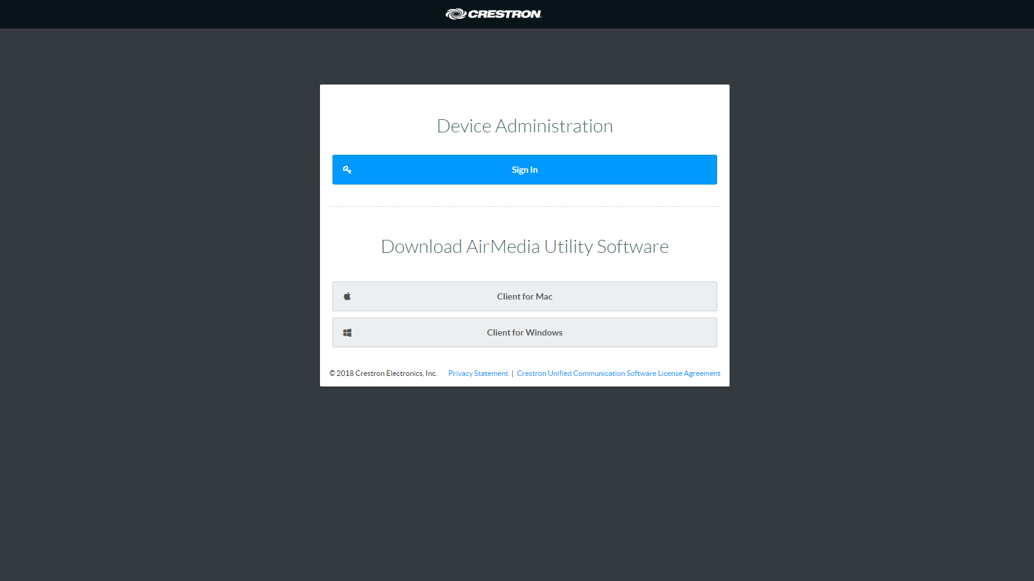
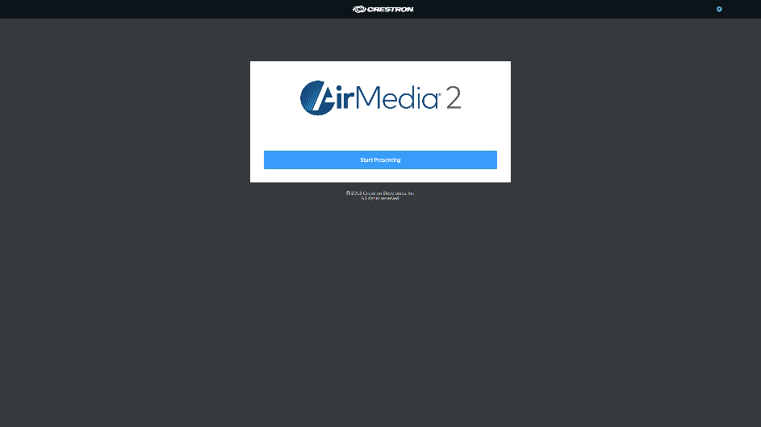
AirMedia 2.0: New connection experience Click “Start Presenting” and then enter code – you’re connected!
BEFORE
AFTER

Slide 19
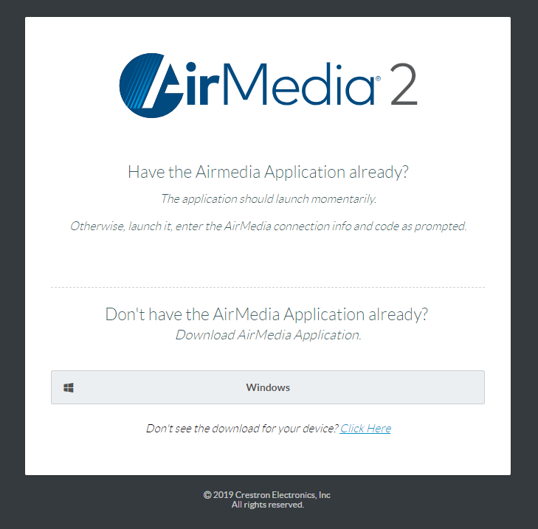
Easy does it
Simple connection
Connects from any browser on any network, in seconds
True BYOD
Detects device and provides the necessary instructions
Guides the user
Navigates to the necessary downloads and app store

Slide 20
Integration with PoE occupancy sensor, Google Calendar™ support, Crestron Certified Drivers integration
Control and route any 2 of 12 possible inputs
Dynamic Canvas
Multi-source support with automatic and dynamic layout.
Moderation
Limits canvas control to a single moderator.
Automatic layout of wired, wireless, and Airboard sources on screen
+Wi-Fi® Access Point Mode
Moderator has exclusive control of the canvas and manages the presentation experience
Total Room Flexibility
Canvas Control
Added peripheral and service support to streamline and simplify your room installation.
Simple control of all sources and users.

Slide 21
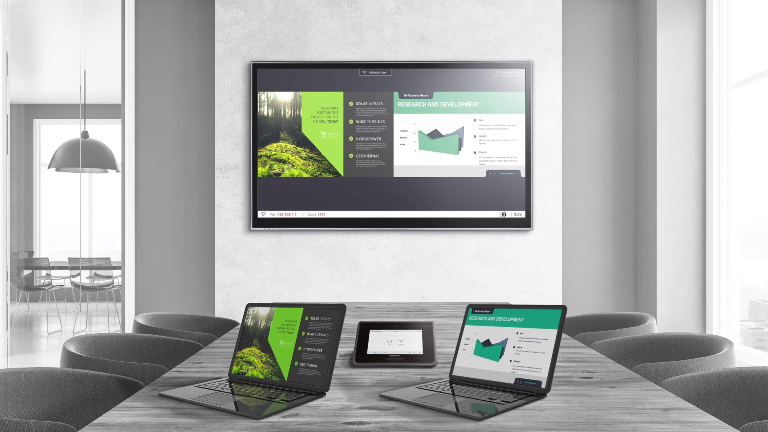
Dynamic Canvas

Slide 22
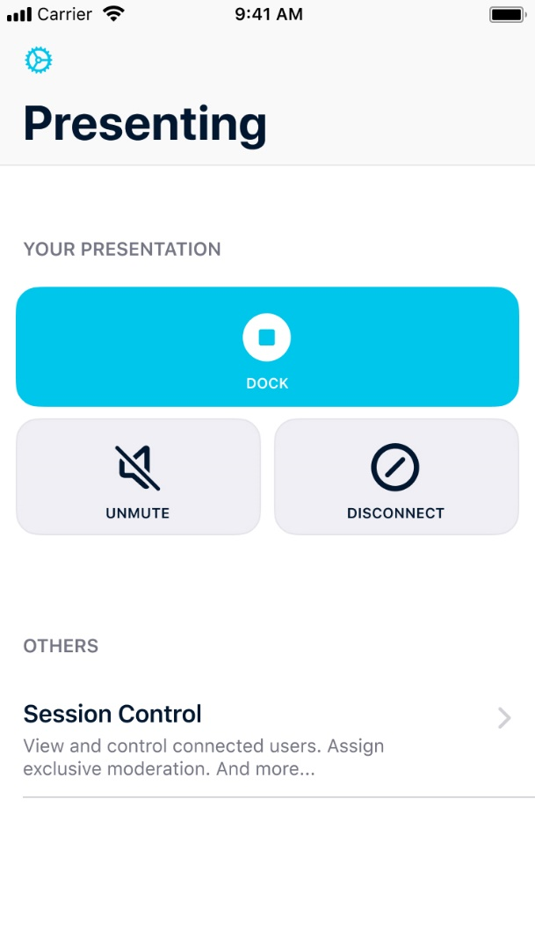
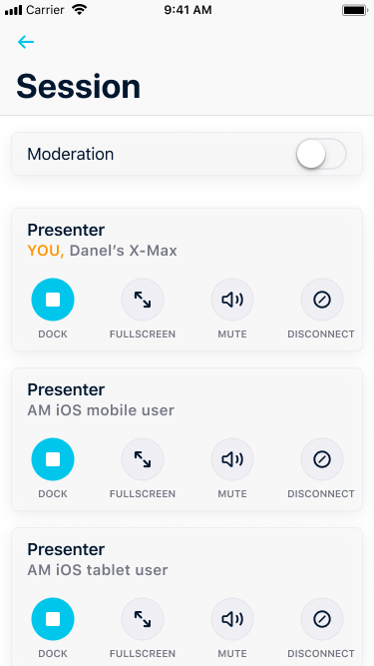
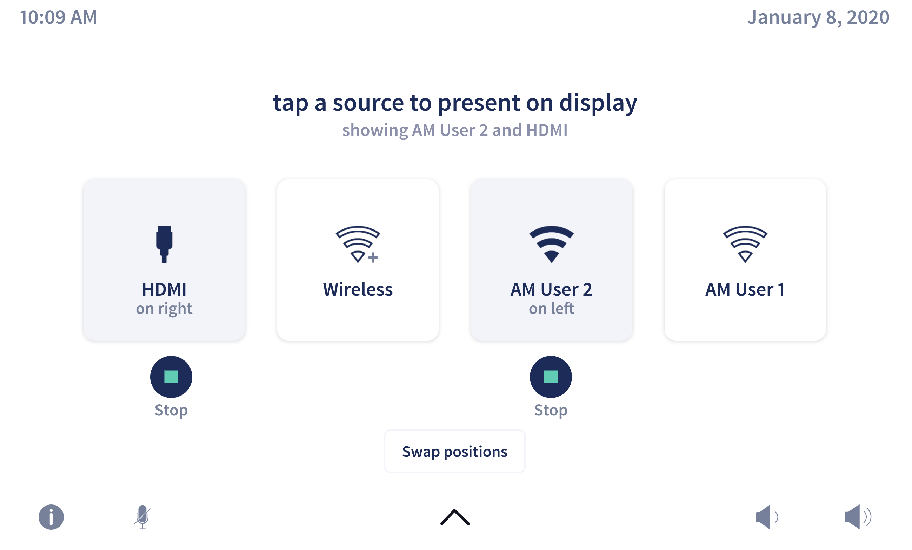
(Coming Soon for Mobile Devices)
Canvas Control

Slide 23
(Coming Soon)
Moderation
Moderation provides exclusive control of who is presenting on the Canvas
Includes wireless and wired sources
Personal device control of AirMedia spaces enables touchless interaction in the room

Slide 24
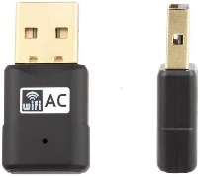
Wi-Fi® Guest Access Point Mode (for guest users)

Slide 25
Front-of-room experience: Light / Dark theme

Slide 26
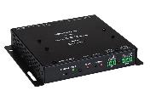
Modern authentication for Office 365® scheduling integration
On July 3rd, 2018 Microsoft announced the following for Exchange Web Services API for Office 365
Basic authentication for Office 365 will be decommissioned
On October 13th, 2020 they will stop supporting and fully decommission the Basic Authentication for Office 365 for newly created tenants by default and begin to disable basic authentication in tenants that have no recorded usage starting October, 2020.
Modern authentication will be supported in the AM-200/300
Customers will need to go to the web UI or XiO Cloud and switch over to modern authentication. Their tenant account will need to provide application access and will require some configuration from their IT department.
https://techcommunity.microsoft.com/t5/Exchange-Team-Blog/Upcoming-changes-to-Exchange-Web-Services-EWS-API-for-Office-365/ba-p/608055

Slide 27
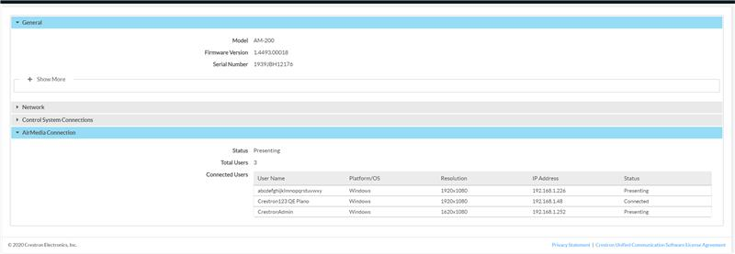
AirMedia connected users: Status page

Slide 28
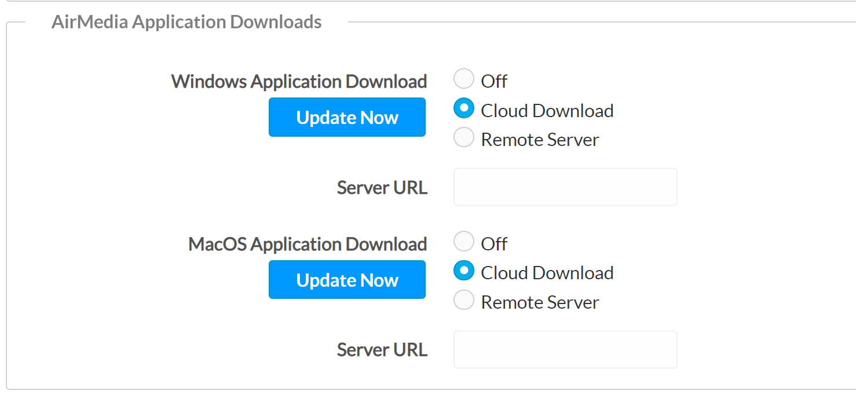
Application downloads from the cloud
Automatic downloads from the cloud allow IT managers to set it and forget it. No need to wait for the next firmware release.

Slide 29
Add touchless collaboration to any space
All brand names, product names, and trademarks are the property of their respective owners. Certain trademarks, registered trademarks, and trade names may be used in this document to refer to either the entities claiming the marks and names or their products. Crestron disclaims any proprietary interest in the marks and names of others. Crestron is not responsible for errors in typography or photography. © 2020 Crestron Electronics, Inc.

